Slide 1
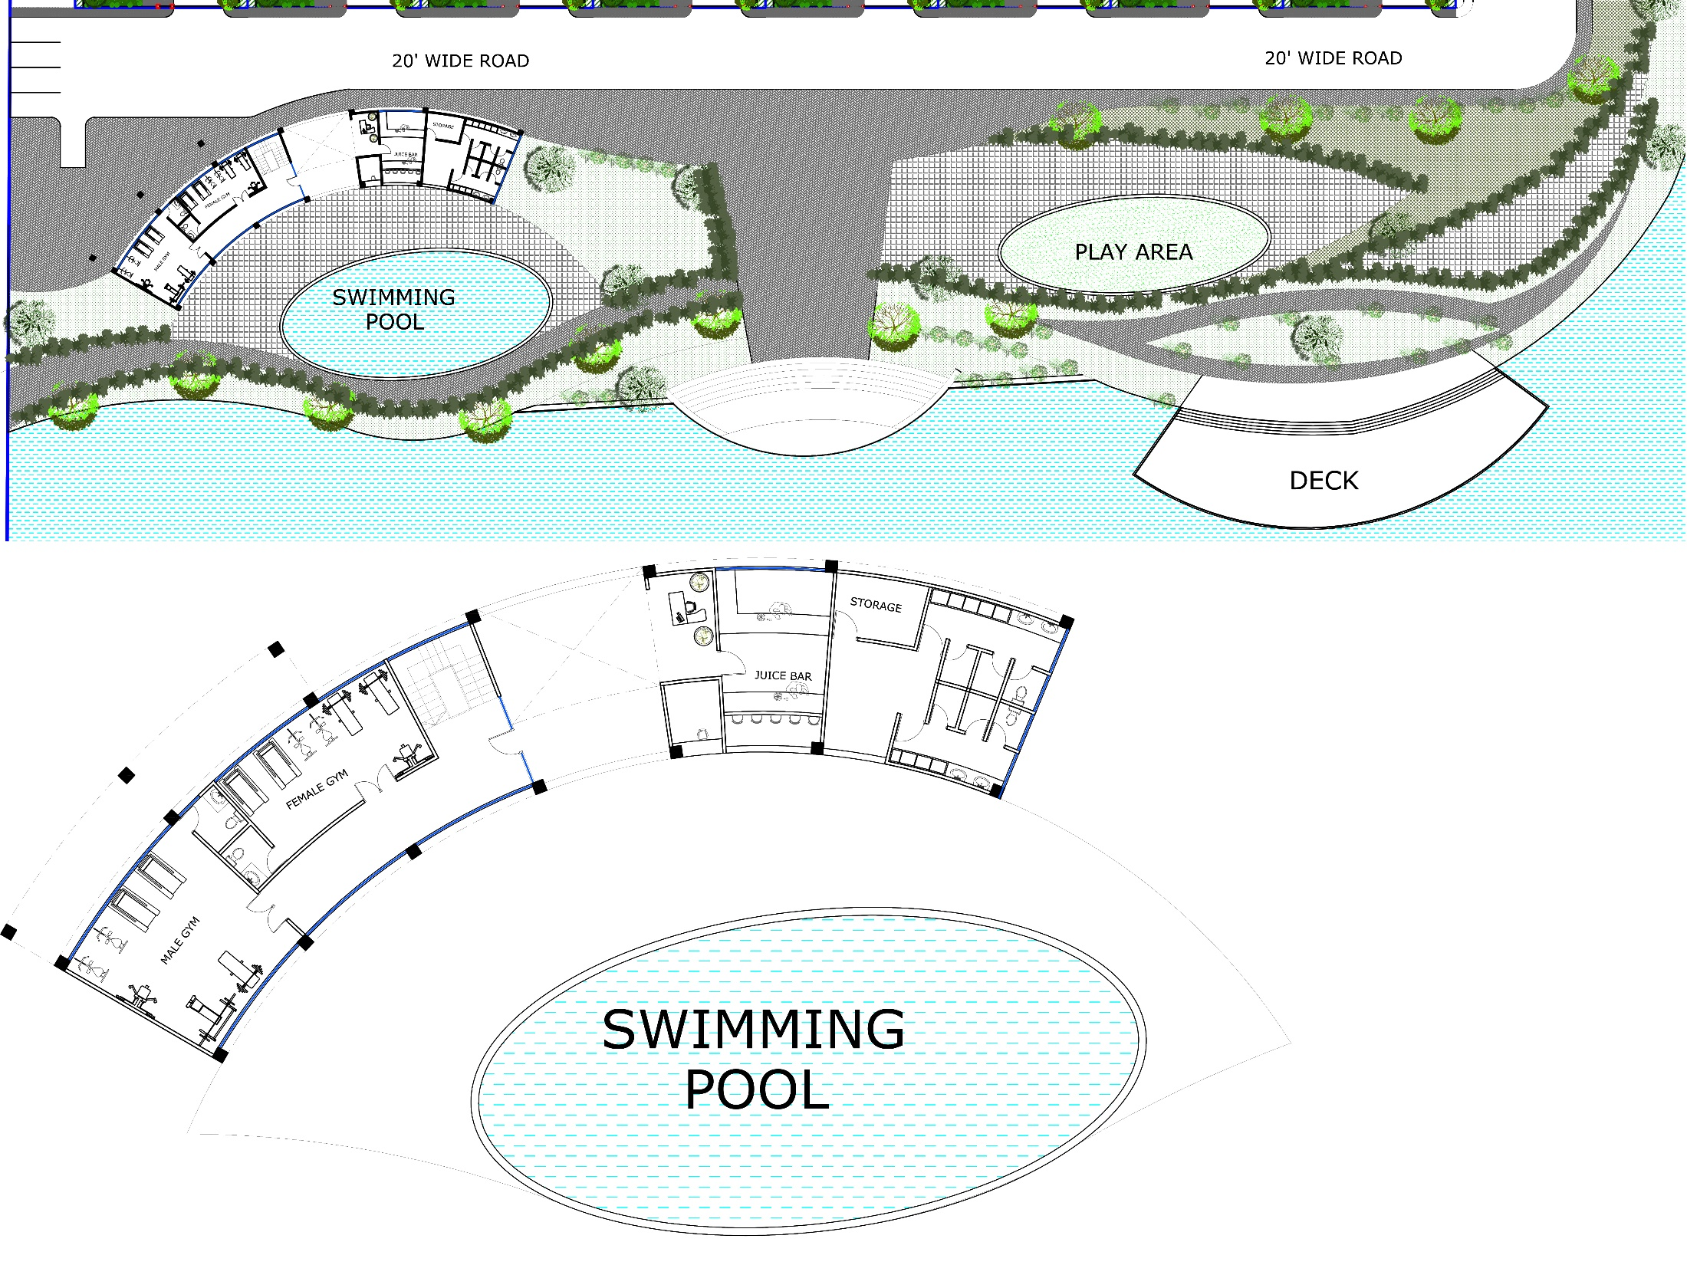
CLUB
GROUND FLOOR PLAN

Slide 2
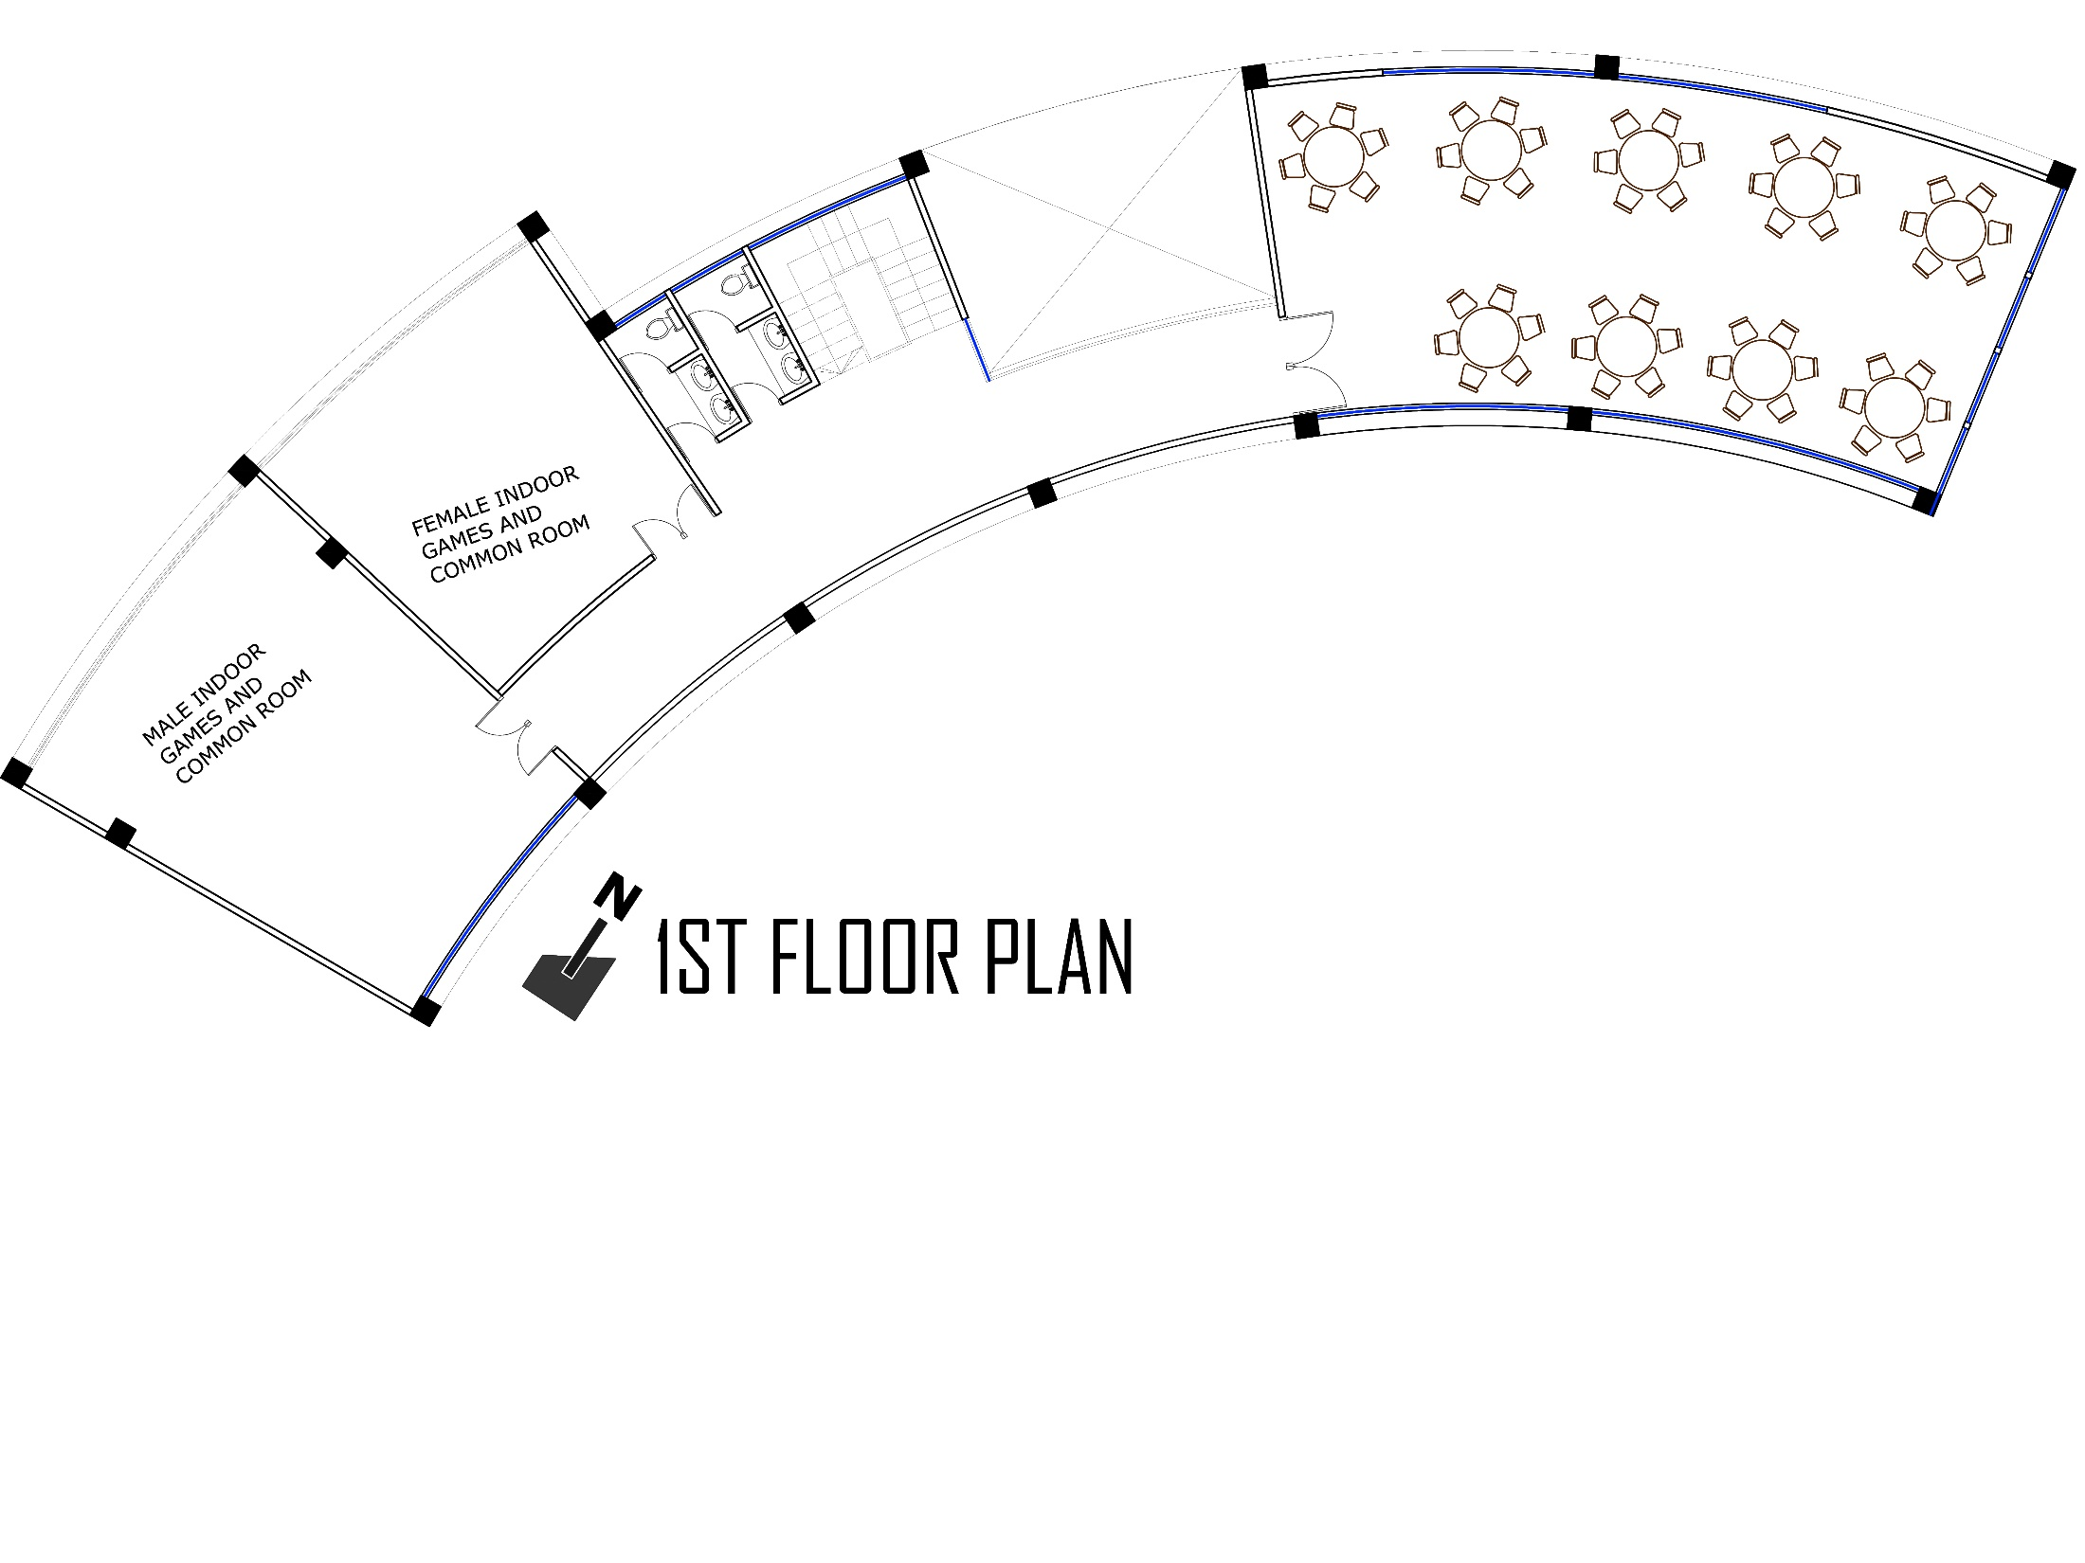
CLUB
1ST FLOOR PLAN

Slide 3
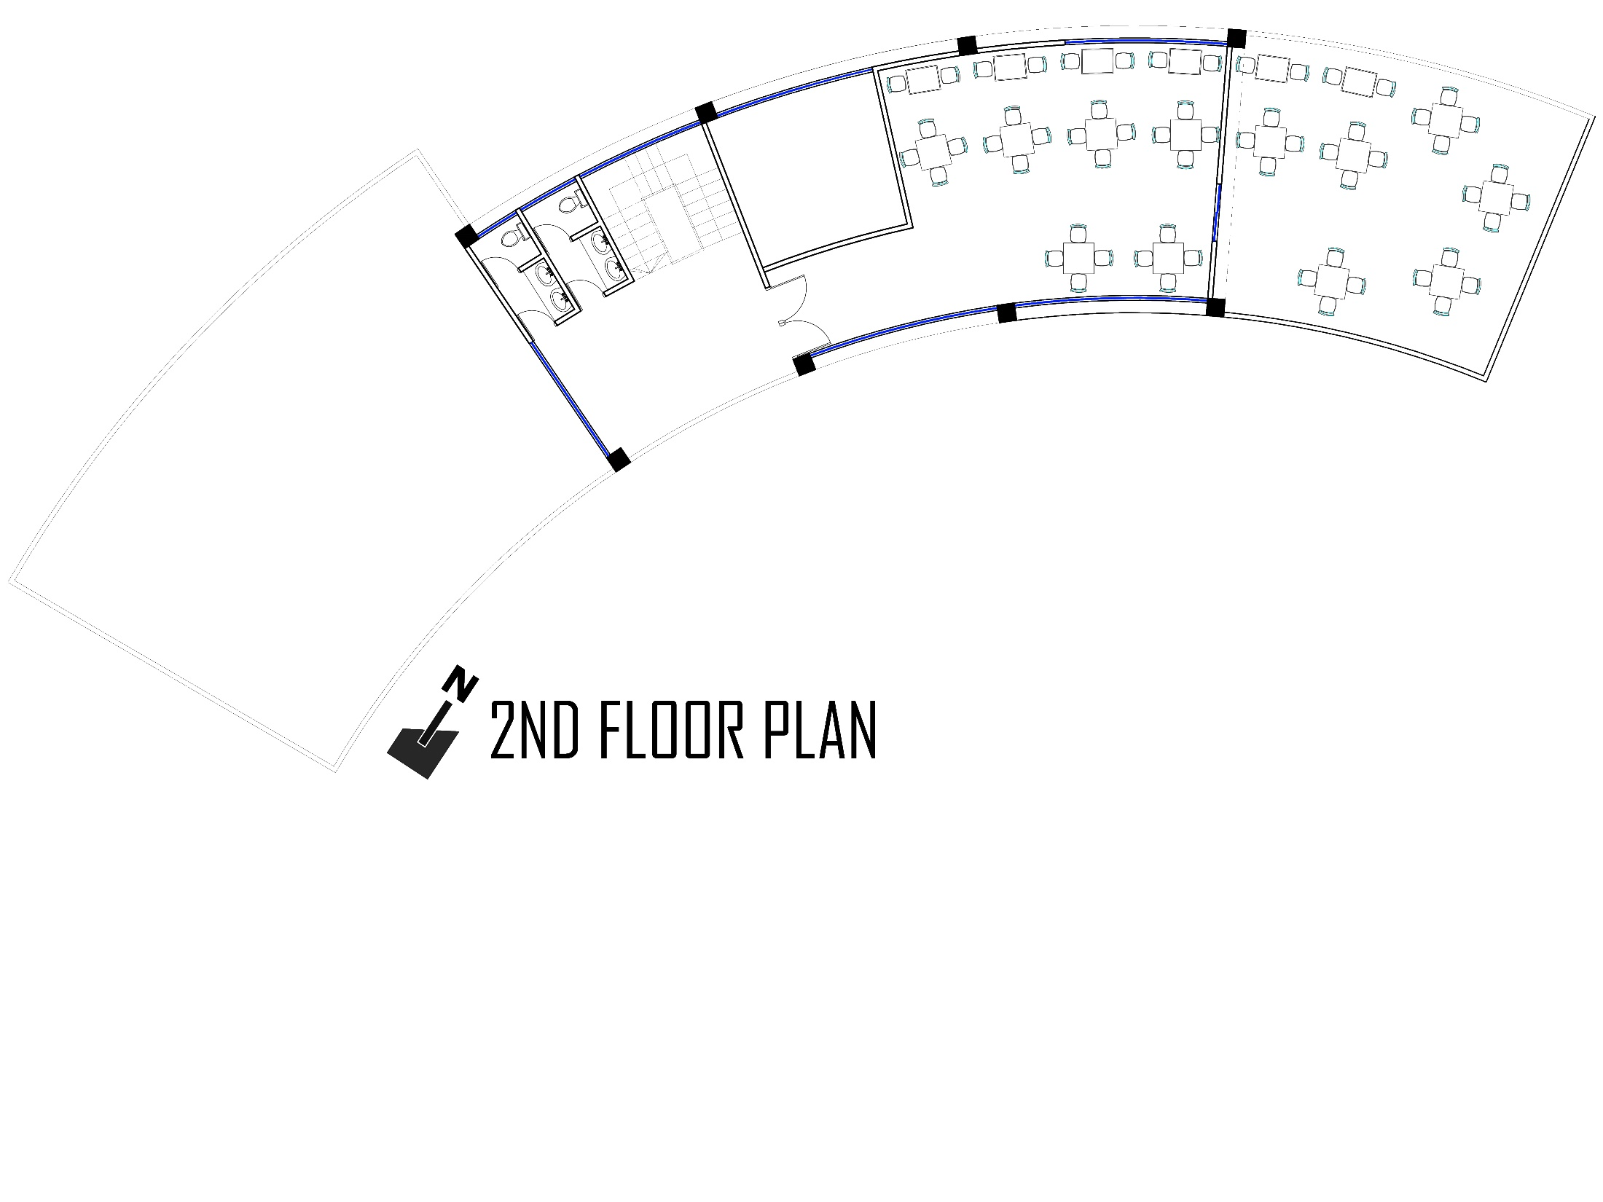
CLUB
1ST FLOOR PLAN

Slide 4
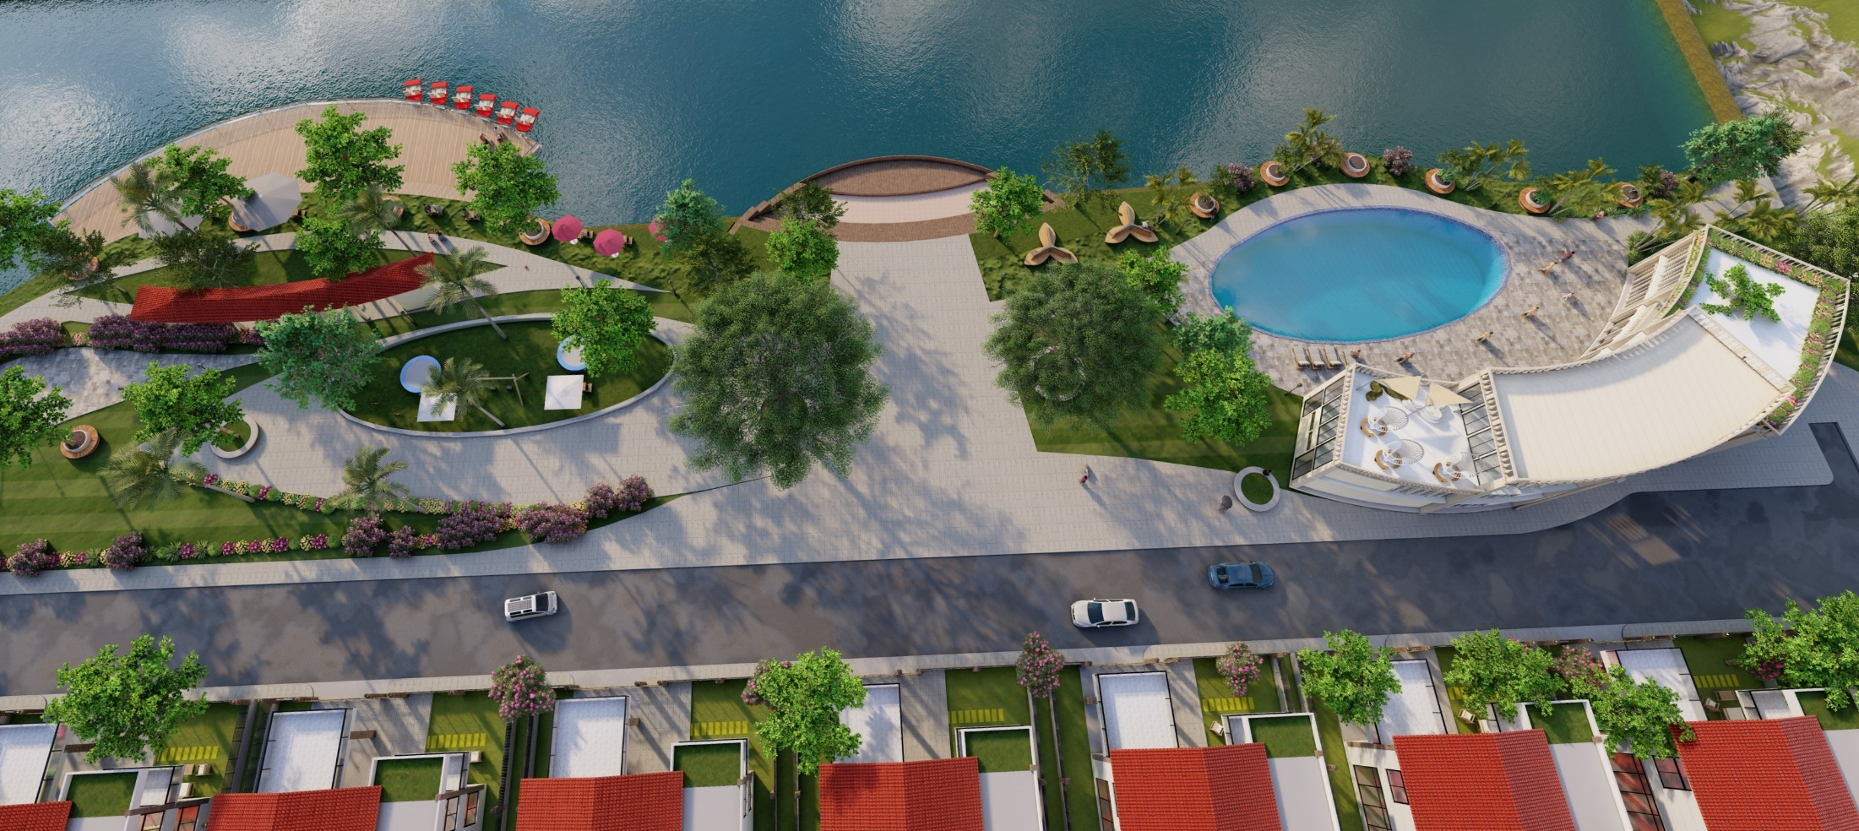
CLUB
TOP VIEW

Slide 5
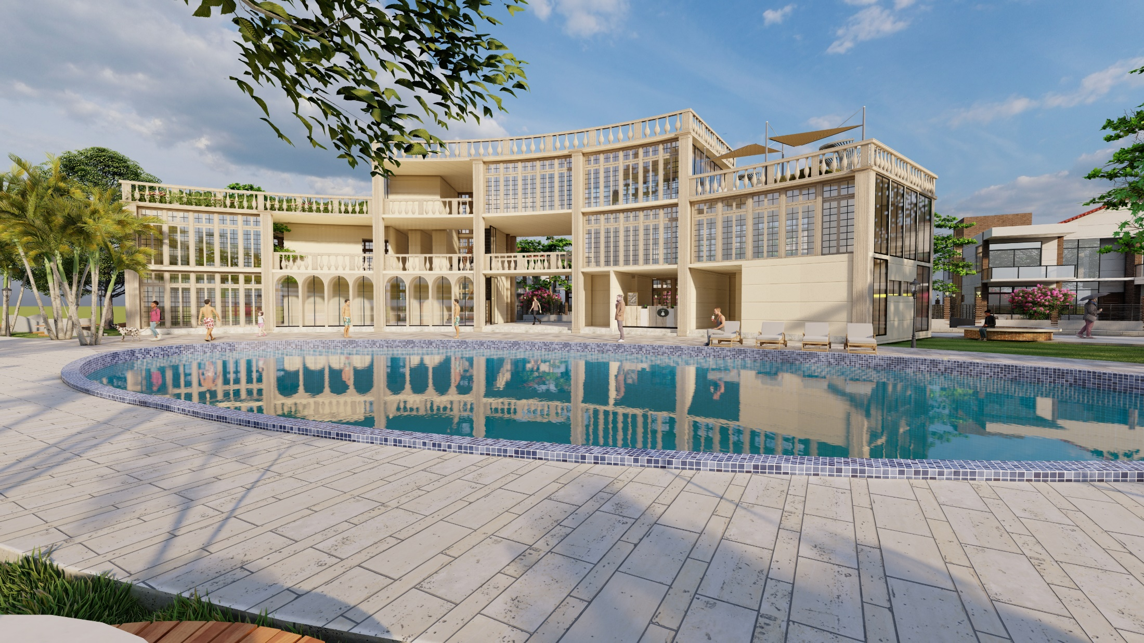
CLUB
3D VIEW (FRONT)

Slide 6
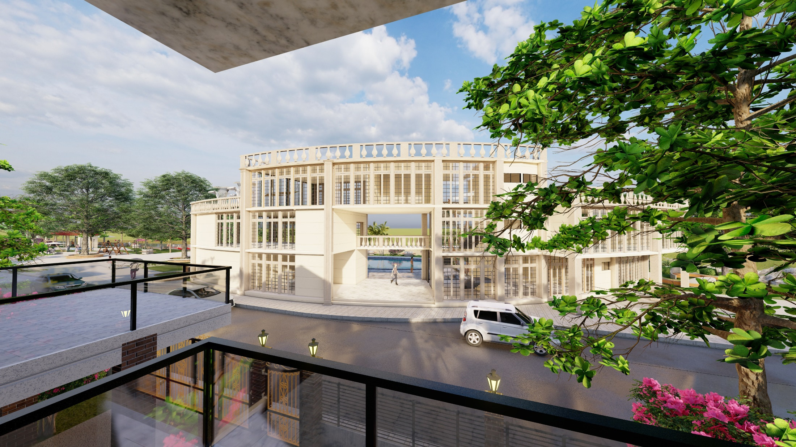
CLUB
3D VIEW (BACK)

Slide 7
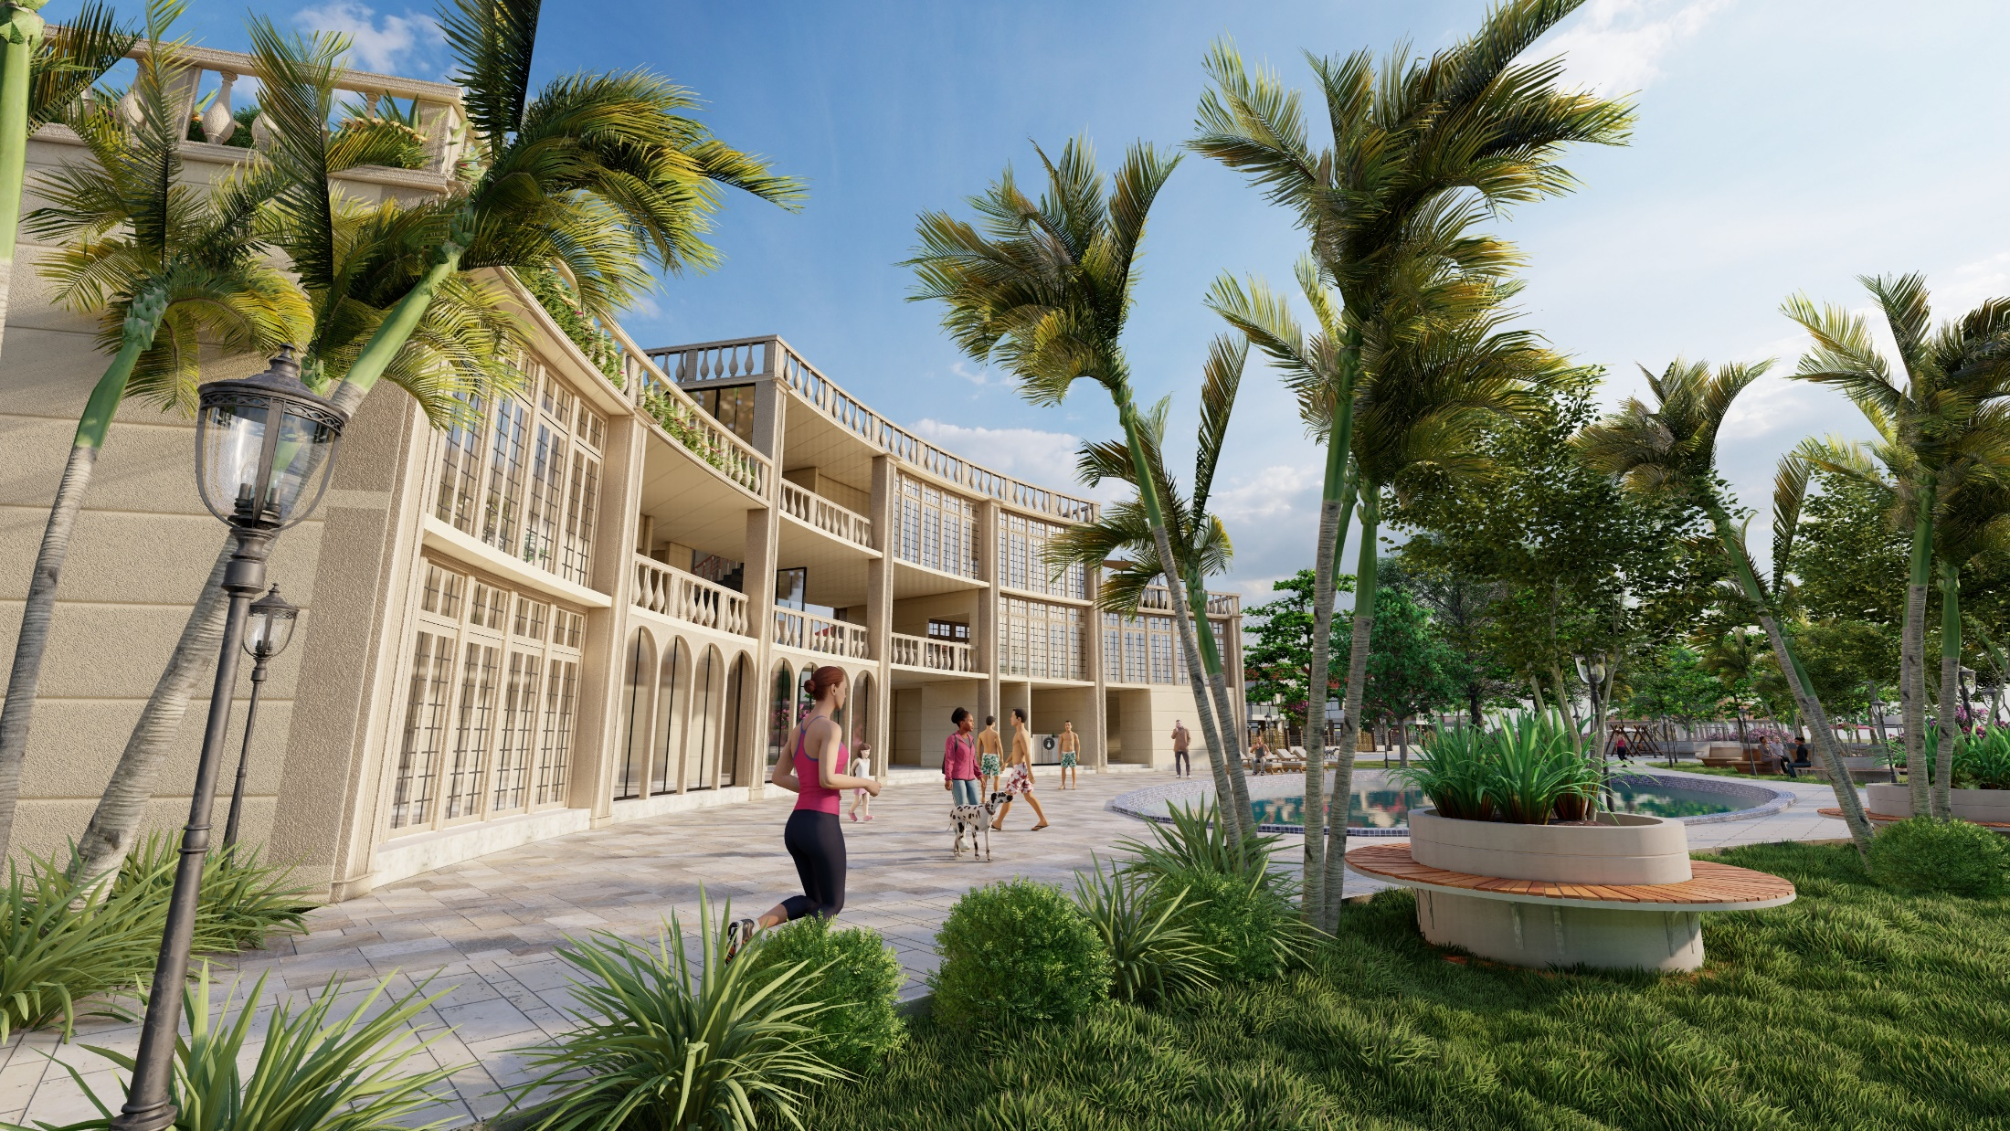
CLUB
3D VIEW (SIDE)

Slide 8
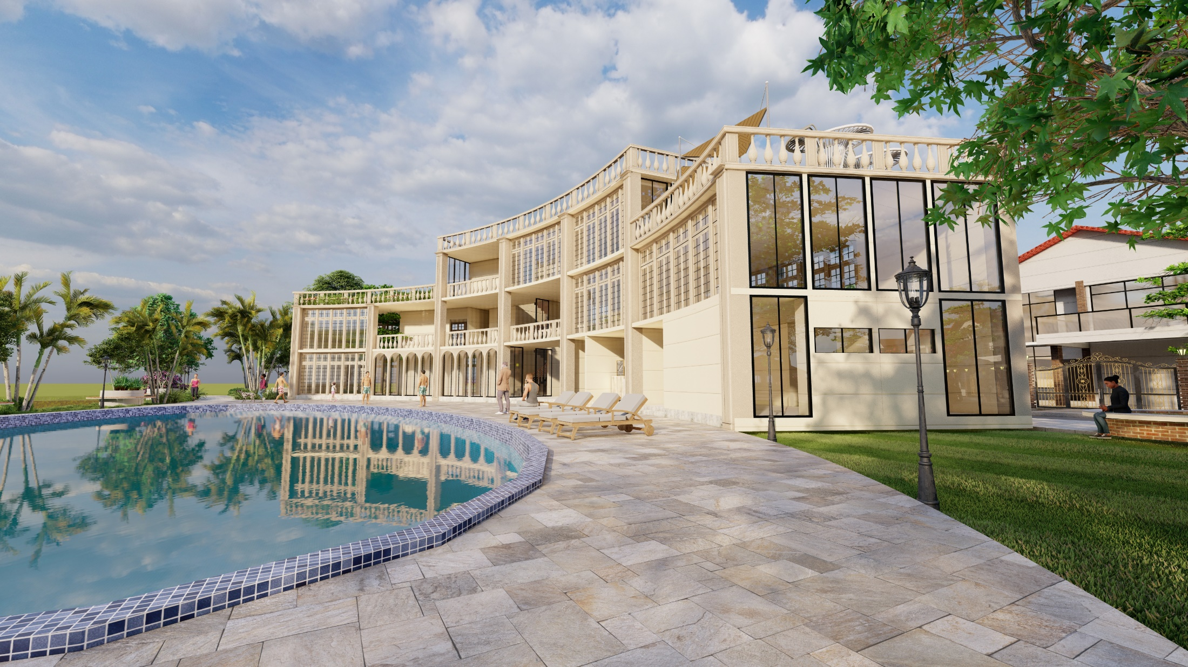
CLUB
3D VIEW (SIDE)

Slide 9
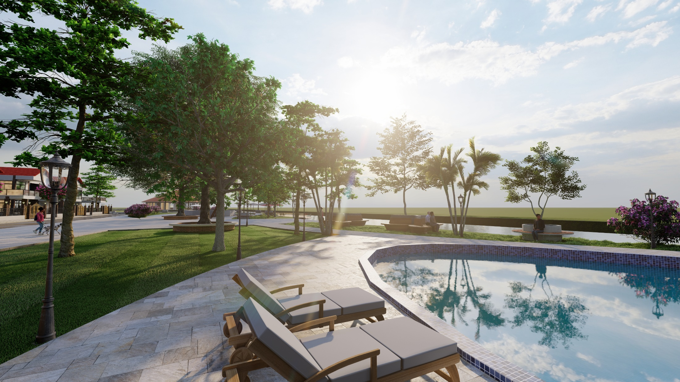
CLUB
3D VIEW (POOL SIDE)

Slide 10
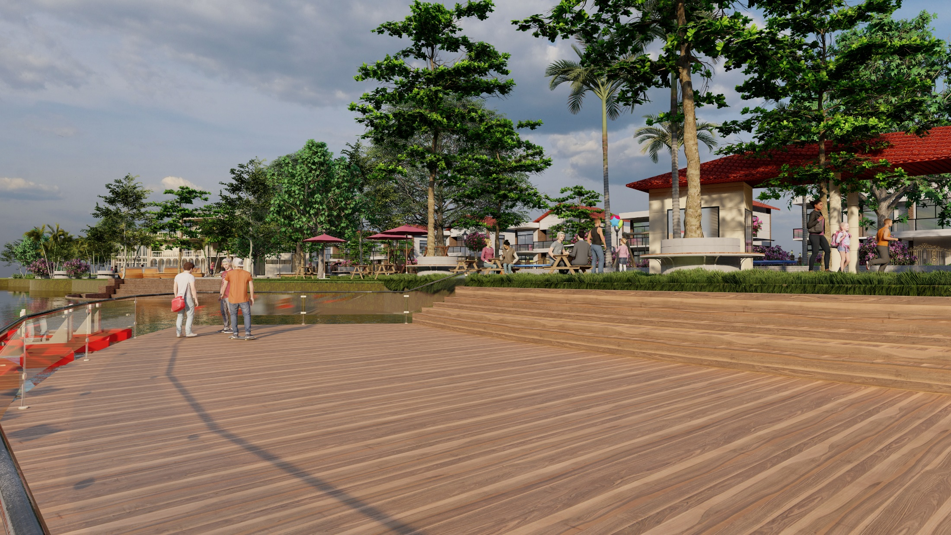
CLUB
3D VIEW (DECK SIDE)

Slide 11
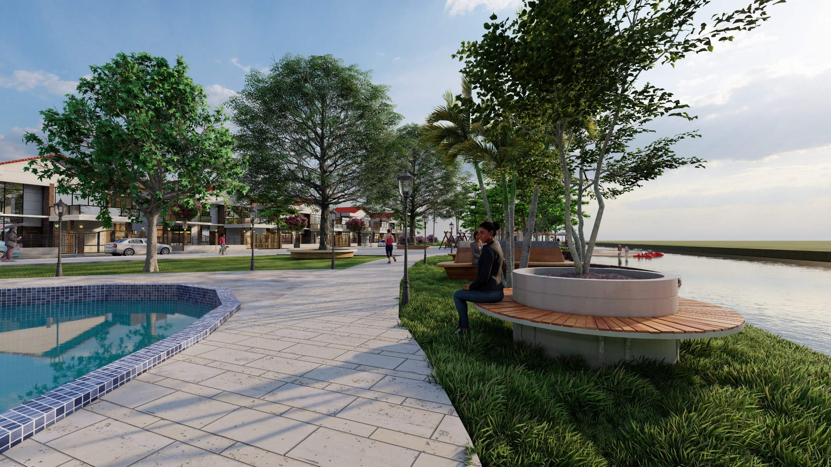
CLUB
3D VIEW (SEATING AREA)

Slide 12
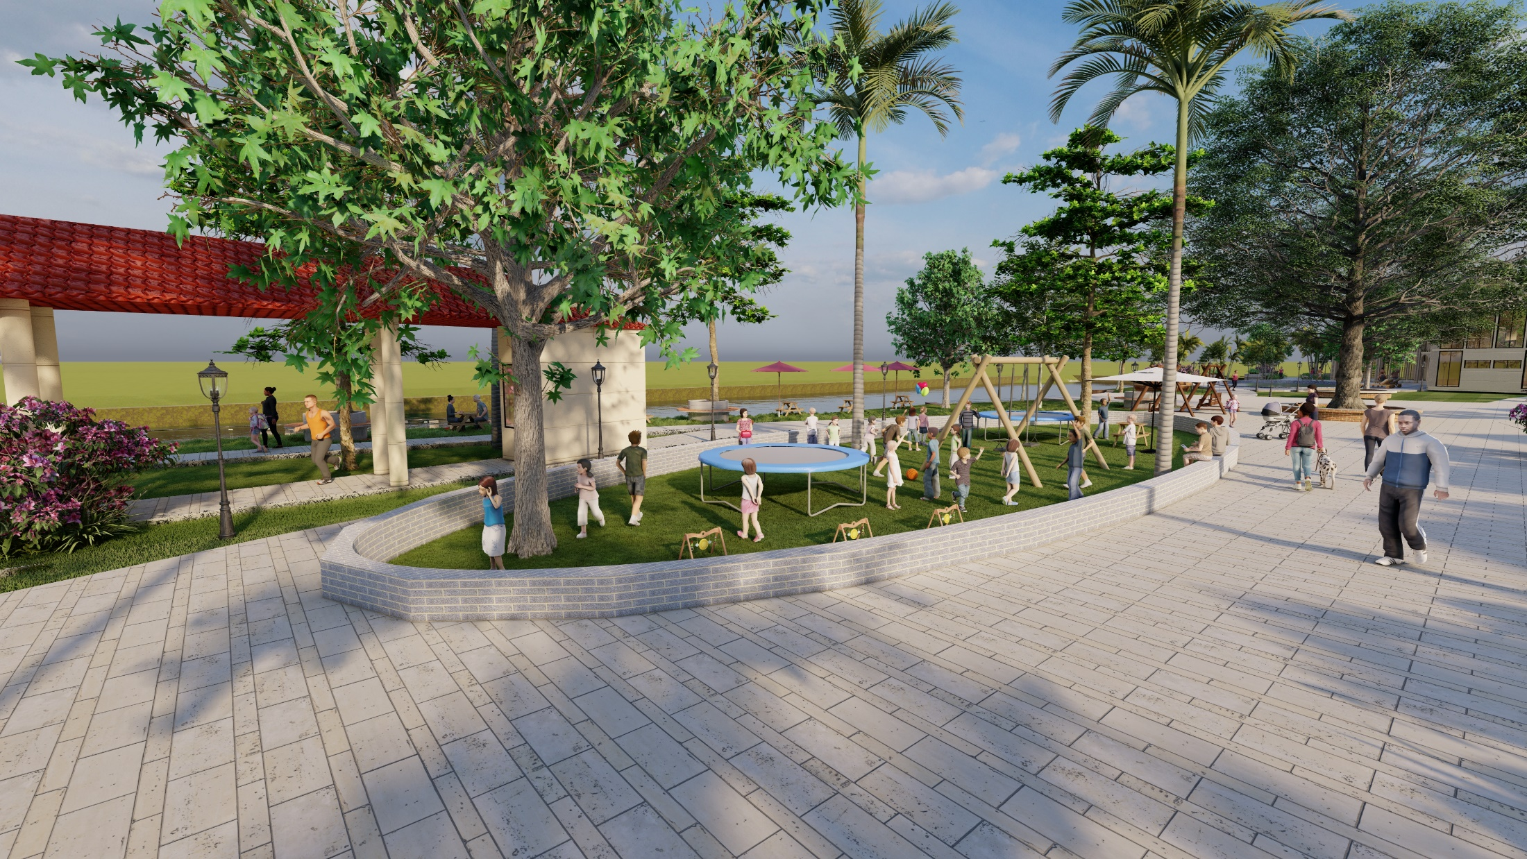
CLUB
3D VIEW (PLAY AREA)

